Slide 1
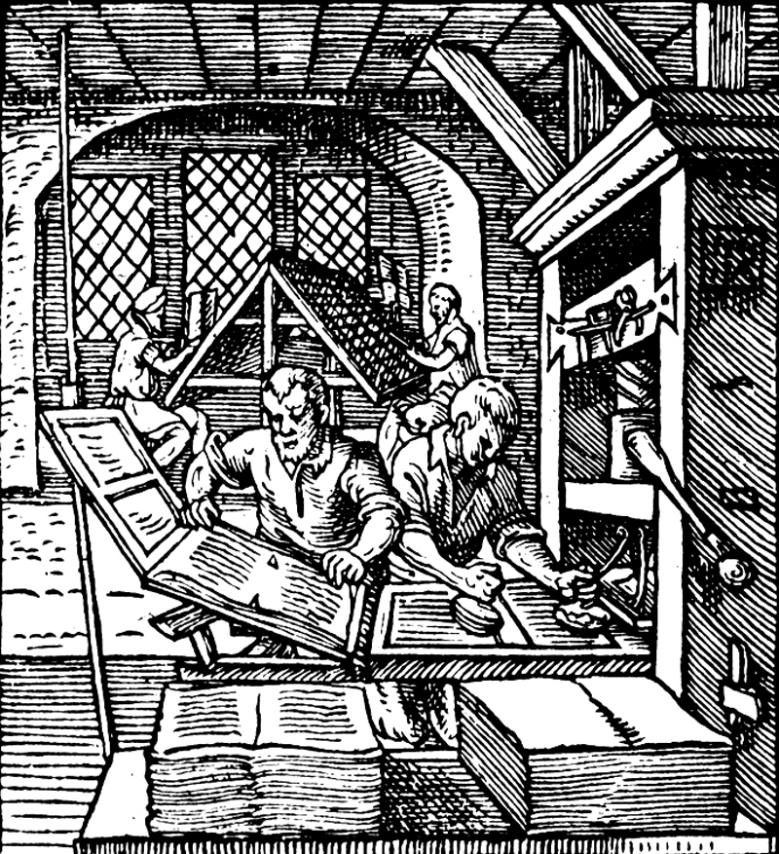
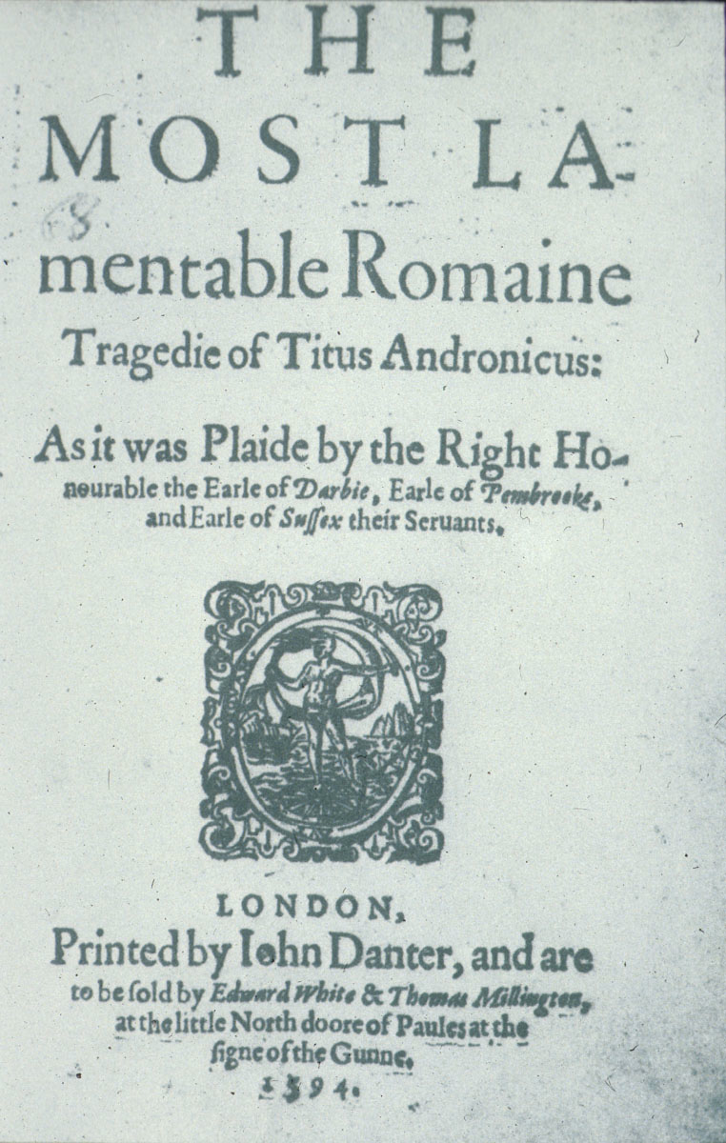
Shakespeare hot off the press teaching with early editions of Shakespeare
English and Media Centre 2019
Emma Smith
Hertford College, University of Oxford
emma.smith@hertford.ox.ac.uk | @OldFortunatus

Slide 2
British Library Shakespeare in Quarto
Full digital facsimiles of all the quarto texts
https://www.bl.uk/treasures/shakespeare/quartos.html

Slide 3
Bodleian First Folio – all the plays in facsimile
firstfolio.bodleian.ox.ac.uk

Slide 4
Titlepages, theatre information and other records
Shakespeare Documented
Shakespearedocumented.folger.edu

Slide 5
plays in print

Slide 6
No Shakespeare manuscripts

Slide 7
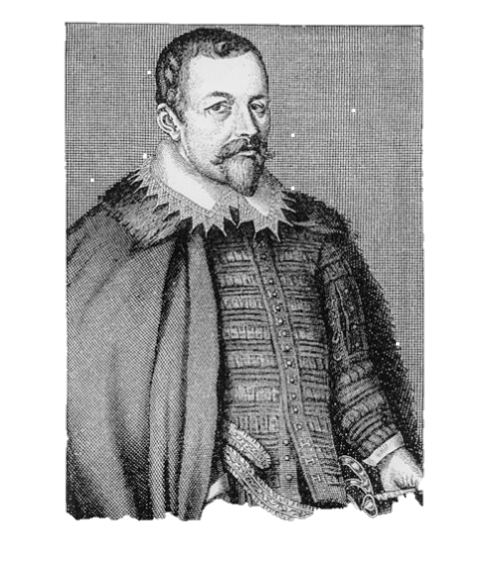
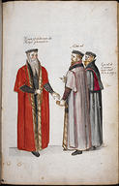
Thomas Bodley’s advice to his Librarian
Haply some plays may be worthy the keeping, but hardly one in forty.
stage-plays contain nothing but profane fables, lascivious matters, cozening devices and scurrilous behaviours

Slide 8
Shakespeare in print
19 Shakespeare plays in print from 1594-1622
Narrative poem Venus and Adonis Shakespeare’s most popular book
Most reprinted plays in this period are histories: Henry IV Part 1 and Richard III (each in 6 editions)

Slide 9
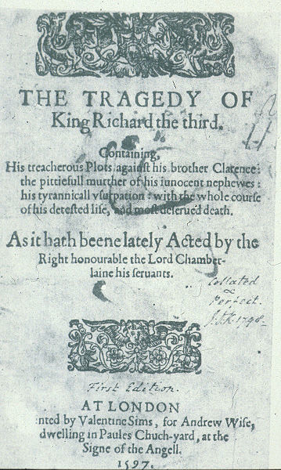
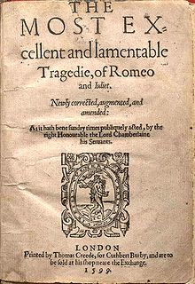
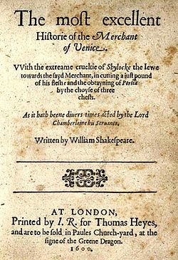
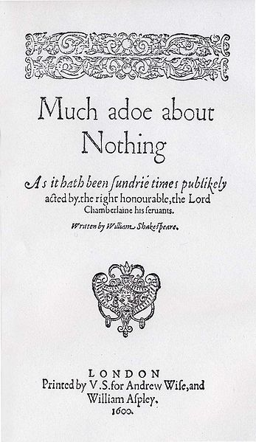
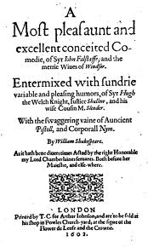
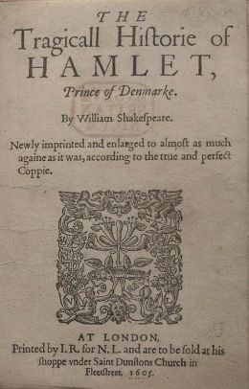
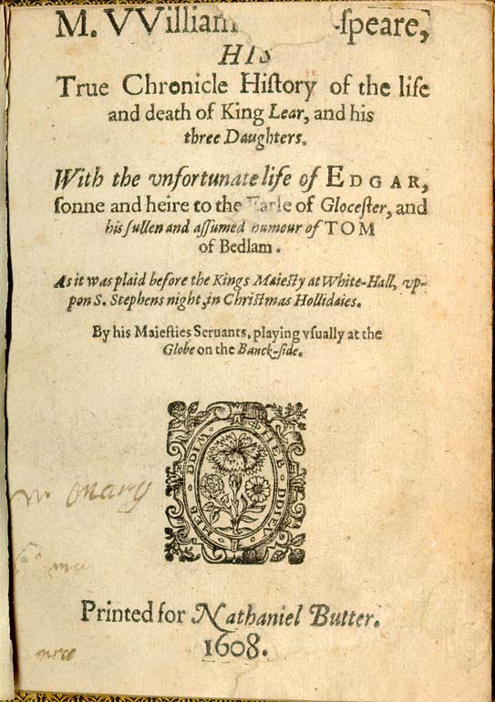
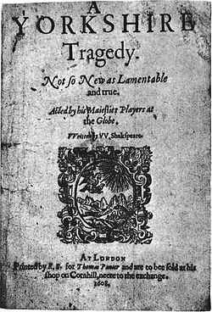
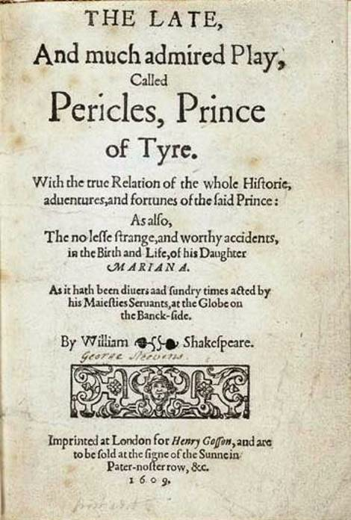
quarto publications
From Shakespeare Documented

Slide 14
The First Folio, 1623
Posthumously printed (Shakespeare dies 1616)
Prepared by fellow King’s Men actors John Heminge and Henry Condell
Does not include poems or sonnets, or Pericles or Two Noble Kinsmen

Slide 15
36 plays (Troilus and Cressida included, but not listed)
Does not include Pericles or Two Noble Kinsmen
Divided by genre (not, for instance, by chronology: compare modern collected editions)

Slide 16
reading the Folio plays

Slide 17
reading the Folio plays

Slide 18
reading the Folio plays

Slide 19
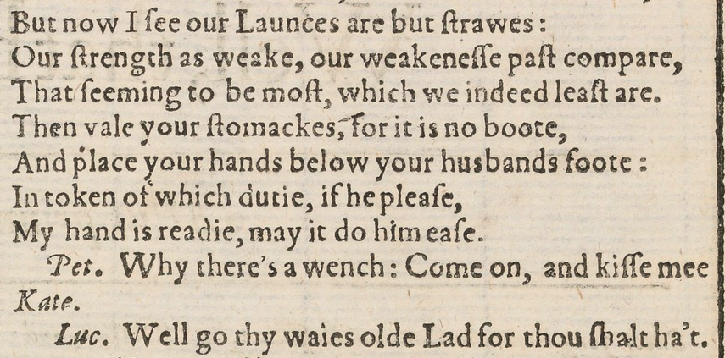
reading the Folio plays

