Slide 1
#EMCJustWrite19
#NationalWritingDay
#YourSchoolName

Slide 2
Instructions for EMC Just Write!
Look at the activities on the slides that follow. (There’s a slide with all of them on at the end.)
Choose one and spend up to 30 minutes just writing!
Your teacher can take pictures of your work and send it to the English and Media Centre Twitter account @EngMediaCentre
#EMCJustWrite19 #NationalWritingDay #YourSchoolName

Slide 7
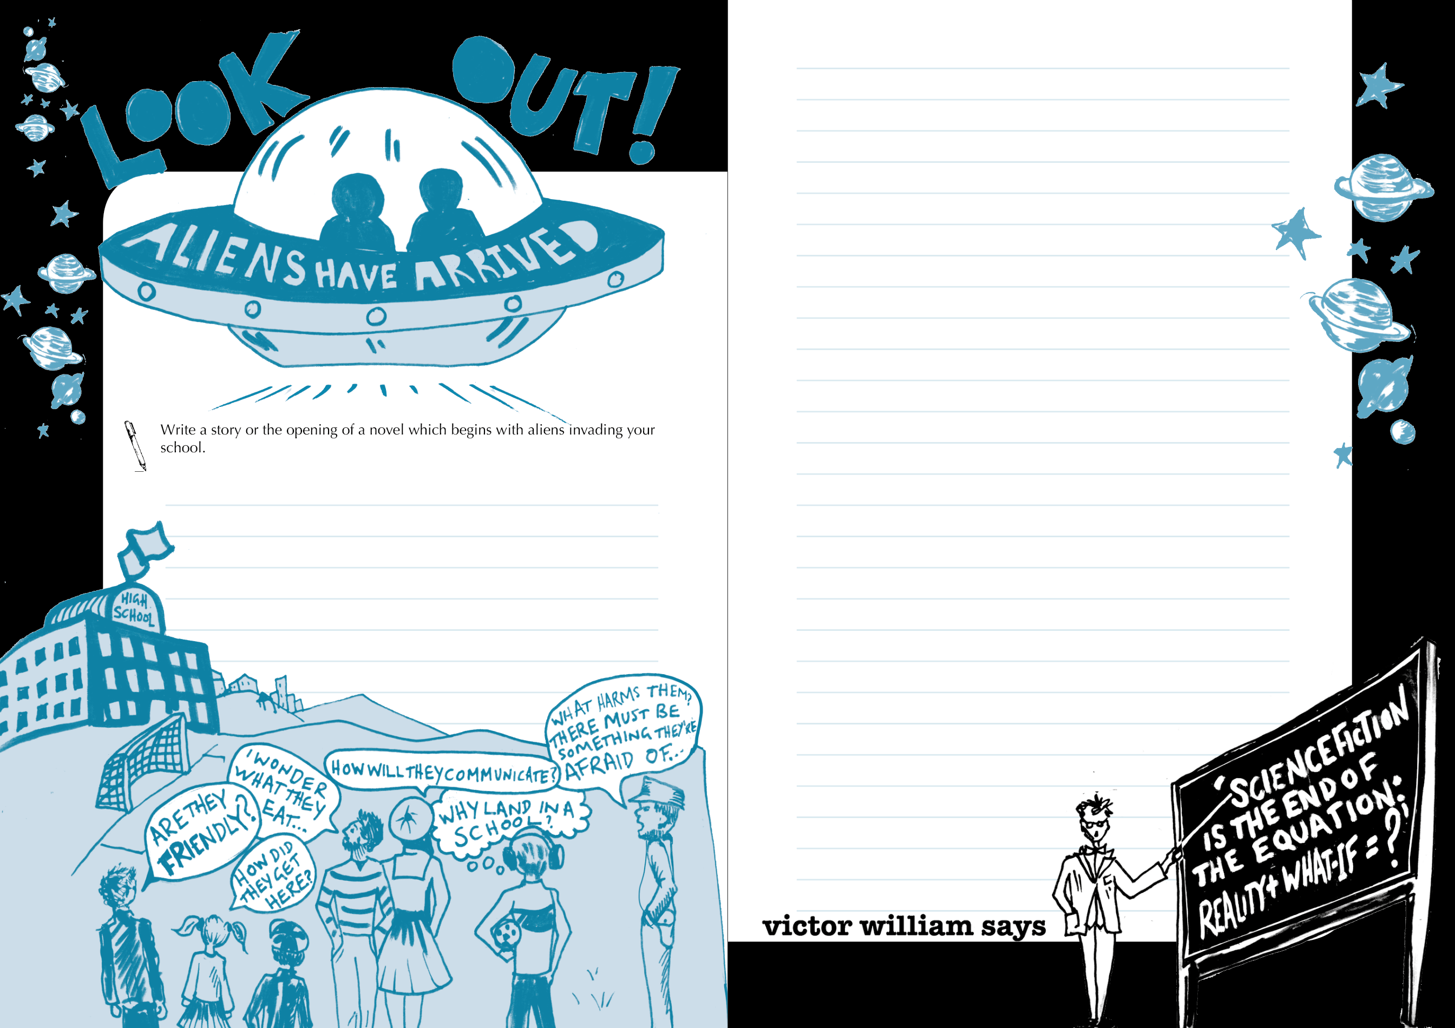
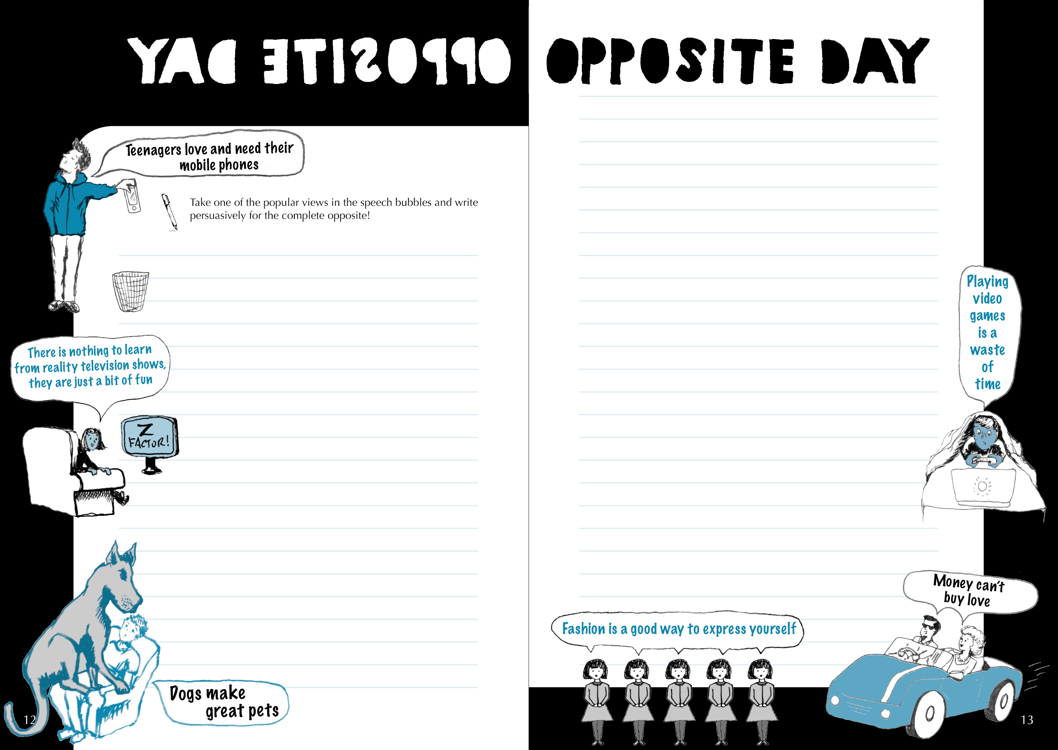
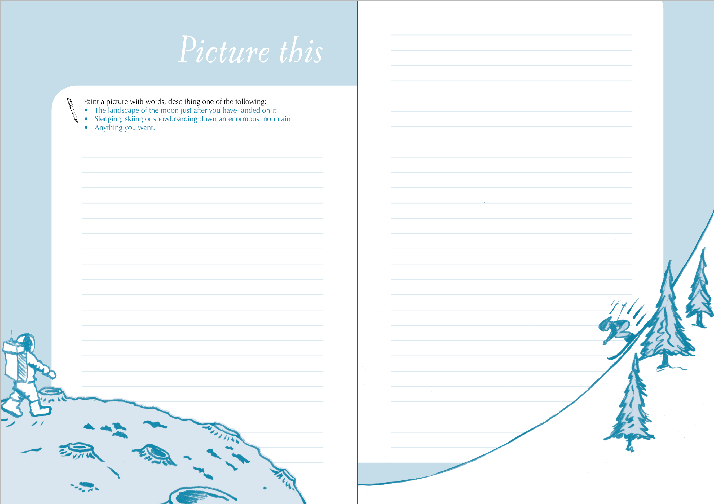

Slide 8
https://www.englishandmedia.co.uk/publications/just-write-emc-let-them-loose
Full details, samples and how to order here:

